Slide 2
These pages have been prepared for discussion purposes only and do not constitute legal advice. You should obtain your own legal advice based on your particular circumstances. Copyright in these pages is retained by the relevant authors.
This work is licensed under a Creative Commons Attribution Non-Commercial, Share-Alike 4.0 International Licence

Slide 3
These slides are based on the original submissions made to relevant Joint Federal Parliamentary Committees as follows:
Foreign Influence Transparency Scheme Bill 2017 submissions at: https://www.aph.gov.au/Parliamentary_Business/Committees/Joint/Intelligence_and_Security/TransparencySchemeBill/Submissions
ALHR submission No 7, Valerie Heath submission No 15
National Security Legislation Amendment (Espionage and Foreign Interference) Bill 2017 submissions at:
https://www.aph.gov.au/Parliamentary_Business/Committees/Joint/Intelligence_and_Security/EspionageFInterference/Submissions ALHR submission No 7, Human Rights Law Centre submission No 10, Valerie Heath submission No 14
Electoral Legislation Amendment (Electoral Funding and Disclosure Reform) Bill 2017, submissions at: https://www.aph.gov.au/Parliamentary_Business/Committees/Joint/Electoral_Matters/ELAEFDRBill2017/Submissions
ALHR submission No 65, Human Rights Law Centre submission No 142
Identity-matching Services Bill 2018 and the Australian Passports Amendment (Identity-matching Services) Bill 2018, submissions at: https://www.aph.gov.au/Parliamentary_Business/Committees/Joint/Intelligence_and_Security/IMSBill/Submissions
ALHR submission No 2

Slide 4
_
‘Foreign Transparency’ Scheme
Note: these pages have been prepared for discussion purposes only and do not constitute legal advice. You should obtain your own legal advice based on your particular circumstances. © ALHR 2018

Slide 5
JAILED FOR CALLING YOUR MOTHER!
… or another relative, or a friend…..
Note: these pages have been prepared for discussion purposes only and do not constitute legal advice. You should obtain your own legal advice based on your particular circumstances. © ALHR 2018
Notes:
We’re all getting used to companies and governments spying on us in public and in private through our phones and even our electronic devices at home.
But new proposed legislation goes a lot further. It requires SELF-reporting to the government of very ordinary events, if there is some foreign connection.
Could you imagine that you could ever be jailed for calling your Mum
or another relative, or a friend
if you don’t then register your conversation with the Australian Government?

Slide 6
Your family/friends are from a part of the world that is NOT AUSTRALIA
You are an Australian citizen
Your mother/ other relative/ friend you are talking to is not an Australian citizen or a permanent Australian resident
You tell them you are going to take part in some kind of political activity aimed at influencing the government
Note: these pages have been prepared for discussion purposes only and do not constitute legal advice. You should obtain your own legal advice based on your particular circumstances. © ALHR 2018
Notes:
How can this happen? These are the only connections required (see slide).
This legislation covers all English-speaking countries - NZ, England - as well as everywhere else that is NOT AUSTRALIA. Think dual citizenship.

Slide 7
The Bills
Foreign Influence Transparency Scheme Bill 2017
National Security Legislation Amendment (Espionage and Foreign Interference) Bill 2017
Electoral Legislation Amendment (Electoral Funding and Disclosure Reform) Bill 2017
Home Affairs and Integrity Agencies Legislation Amendment Bill 2017
Note: these pages have been prepared for discussion purposes only and do not constitute legal advice. You should obtain your own legal advice based on your particular circumstances. © ALHR 2018
Notes:
Amazingly, this is what the Commonwealth government’s proposed new ‘foreign transparency’ scheme seems to do. Other speakers will discuss the other parts of the legislative package that is being proposed, which have serious impacts on civil society and non-governmental organisations generally. But insufficient focus has been placed on the impact on individuals.
This proposed legislation proves beyond a doubt that we can’t trust politicians to protect our rights and that we desperately need a full scale Human Rights Act, which overrides all other legislation, and is preferably constitutionally entrenched.
But to return to how you could - really - be jailed….let me explain.

Slide 8
What is covered? Pretty much everything
Signing a petition
Attending a demonstration
Writing a blog saying the government should change its policy
Emailing or phoning your local Federal MHR or Senator
Writing letters to a newspaper or website
Note: these pages have been prepared for discussion purposes only and do not constitute legal advice. You should obtain your own legal advice based on your particular circumstances. © ALHR 2018
Notes:
This must be pretty serious political activity!
Not at all.
Activities covered are: communications activity, general political lobbying, parliamentary lobbying and donor activity. for the “purpose” of “political or governmental influence”
These are all defined so widely that the following would be included: signing a petition, attending a demonstration, writing a blog saying the government should change its policy, emailing or phoning your local Federal MHR or Senator (no exemptions for politicians and parliamentary privilege is unlikely to apply in most of these cases).
So… how does jail come into it? Well, if the four conditions we described before exist …..

Slide 9
IF both you and the foreign party or ‘principal’
‘knew or expected that [you]
would or might
undertake the [political] activity’
THEN WHETHER OR NOT YOU UNDERTAKE THE ACTIVITY
the following obligations cut in, some of which will involve fees:
Registration (2) Reporting (3) Record - Keeping
(4) Providing information to regulator
Note: these pages have been prepared for discussion purposes only and do not constitute legal advice. You should obtain your own legal advice based on your particular circumstances. © ALHR 2018
Notes:
So that both you and the foreign ‘principal’ ‘knew or expected that [you] would or might undertake the [political] activity’
THEN WHETHER OR NOT YOU ACTUALLY UNDERTAKE THE ACTIVITY, the following obligations cut in: (see slide) registration…. providing information.

Slide 10
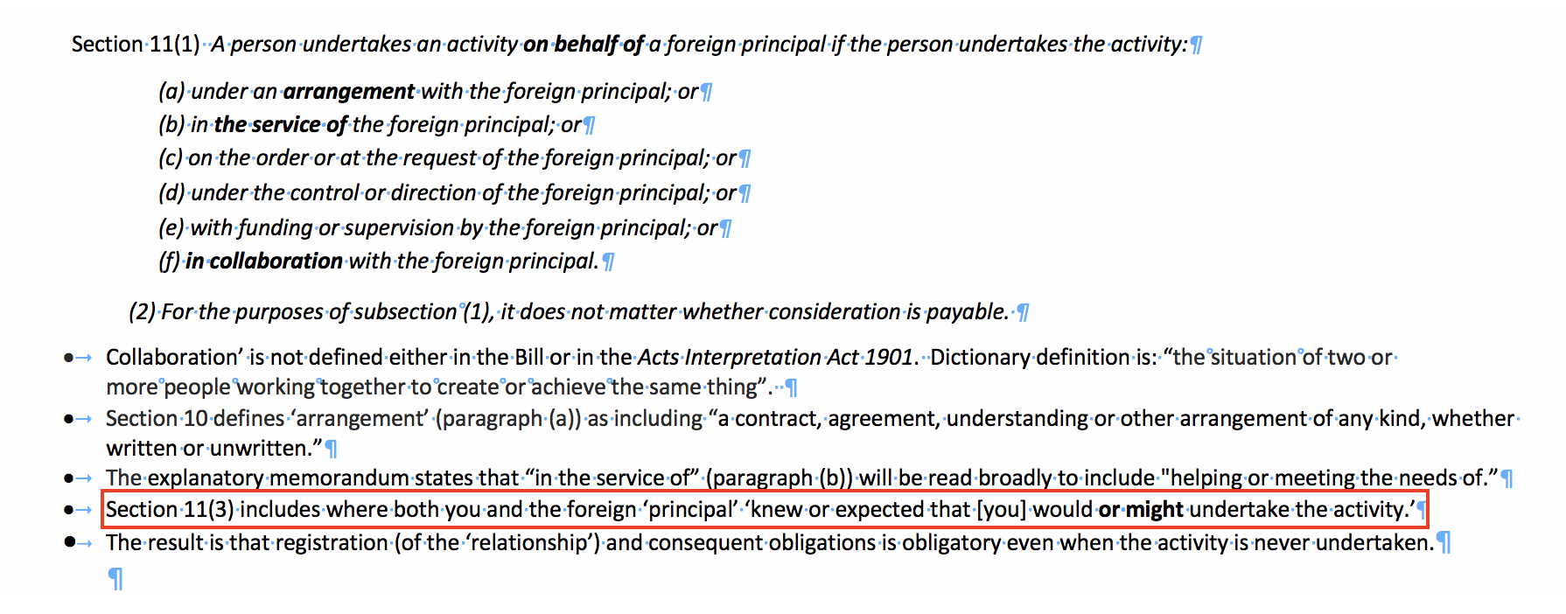
‘On behalf of’
Note: these pages have been prepared for discussion purposes only and do not constitute legal advice. You should obtain your own legal advice based on your particular circumstances. © ALHR 2018
Notes:
We get to this position because ‘on behalf of’ is defined extremely broadly, particularly by section 11(3) (see second last bullet point)

Slide 11
Foreign Principal
Note: these pages have been prepared for discussion purposes only and do not constitute legal advice. You should obtain your own legal advice based on your particular circumstances. © ALHR 2018
Notes:
Given that over 49% of Australians are either born overseas or have one or both parents born overseas – and that they and the other 51% probably all have friends overseas – this legislation has the potential to impact every Australian very severely.

Slide 12
Purpose of Political or government influence
Note: these pages have been prepared for discussion purposes only and do not constitute legal advice. You should obtain your own legal advice based on your particular circumstances. © ALHR 2018
Notes:
The concept of political or government influence is defined extremely widely including to influence the public - or any section of the public – that is, any group of people selected randomnly rather than because of their existing connections - rather than the government.

Slide 13
The Foreign Influence Transparency Scheme Bill 2017 is said to establish a scheme to:
require registration by certain persons undertaking certain activities on behalf of a foreign principal;
require registrants to disclose information about the nature of their relationship with the foreign principal and activities undertaken pursuant to that relationship;
place additional disclosure requirements on registrants during elections and other voting periods;
establish a register of scheme information and provide for certain information to be made publicly available;
provide the secretary with powers to obtain information and documents; and
establish various penalties for non-compliance with the scheme.
Note: these pages have been prepared for discussion purposes only and do not constitute legal advice. You should obtain your own legal advice based on your particular circumstances. © ALHR 2018
Notes:
The Government itself acknowledges this is the effect. The EM to the legislation acknowledges that: "The scheme will:
Require registration by persons undertaking certain activities on behalf of a foreign principal
contain appropriate exemptions for certain activities or classes of persons
require registrants to disclose information about the nature of their relationship with the foreign principal and activities undertaken pursuant to that relationship (both at the initial point of registration and on an ongoing basis for the duration of the relationship)
place additional disclosure requirements on registrants during elections and other voting periods
allow some information to be made publicly available, to serve the transparency purposes of the scheme
be accompanied by charges (for cost recovery purposes)
be supported by powers which will be vested in the Secretary, including issuing notices to produce information or documents and collecting charges, and
be supported by criminal offences for non-compliance."

Slide 14
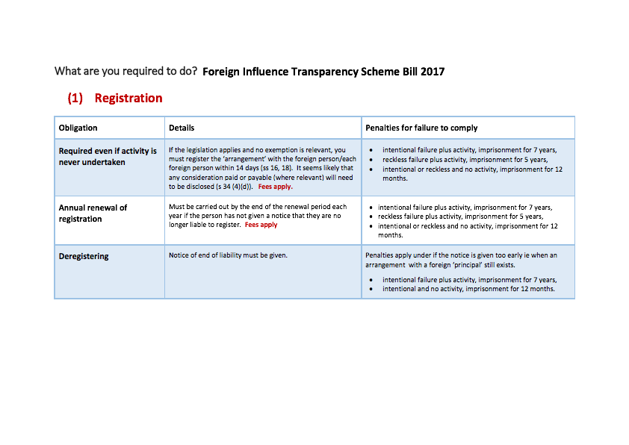
Note: these pages have been prepared for discussion purposes only and do not constitute legal advice. You should obtain your own legal advice based on your particular circumstances. © ALHR 2018
Notes:
You have to register. It is not clear if this is a registration that is once- off for you and that covers every connection you have with foreign persons, or if you have to register separately for each relationship. You have to renew the registration annually for so long as you might undertake any public or private political activity. There is likely to be a fee. You have to deregister only when you are no longer going to undertake any political activity. Severe criminal penalties apply for failure to do this – up to 7 years imprisonment for intentional failure, up to 5 years imprisonment for reckless failure.

Slide 15
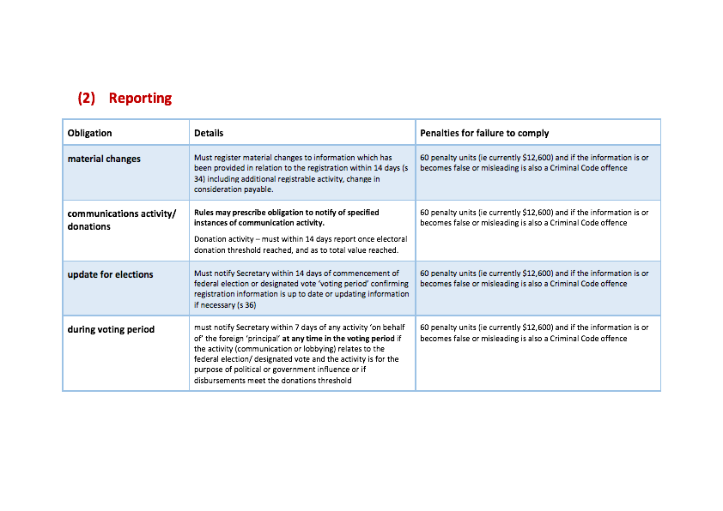
Note: these pages have been prepared for discussion purposes only and do not constitute legal advice. You should obtain your own legal advice based on your particular circumstances. © ALHR 2018
Notes:
You have to report material changes in the information you have provided. You may have to report the content of your activity. You will have tighter reporting timeframes and increased obligations during election periods.

Slide 16
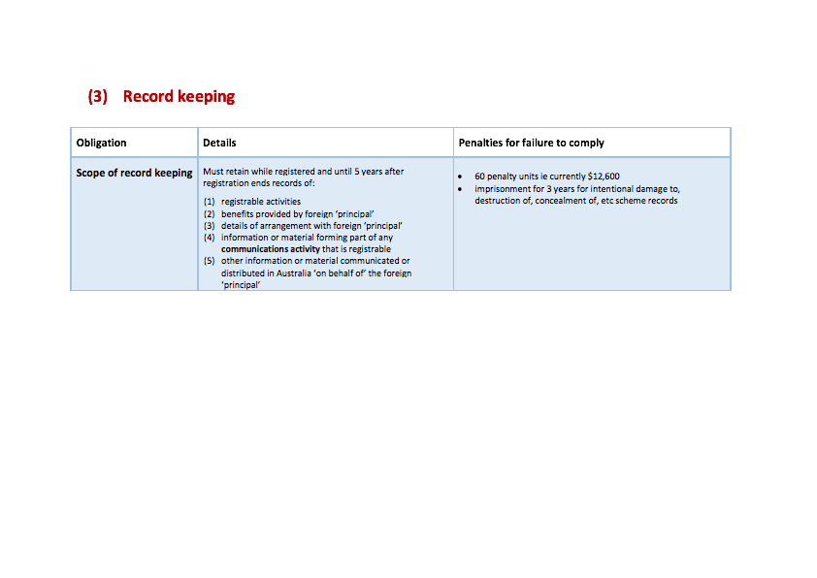
Note: these pages have been prepared for discussion purposes only and do not constitute legal advice. You should obtain your own legal advice based on your particular circumstances. © ALHR 2018
Notes:
You must keep records of all your political activities so that the regulator can ask you about them. This applies during registration and for 5 years after. Severe monetary penalties apply for failure to do this.

Slide 17
Note: these pages have been prepared for discussion purposes only and do not constitute legal advice. You should obtain your own legal advice based on your particular circumstances. © ALHR 2018
Notes:
The Regulator can come calling and ask for information at any time. Providing false or misleading information is a crime punishable with up to 5 years imprisonment. Failure to provide information can be punished by 6 months imprisonment unless you can prove you did everything possible to provide the information.

Slide 18
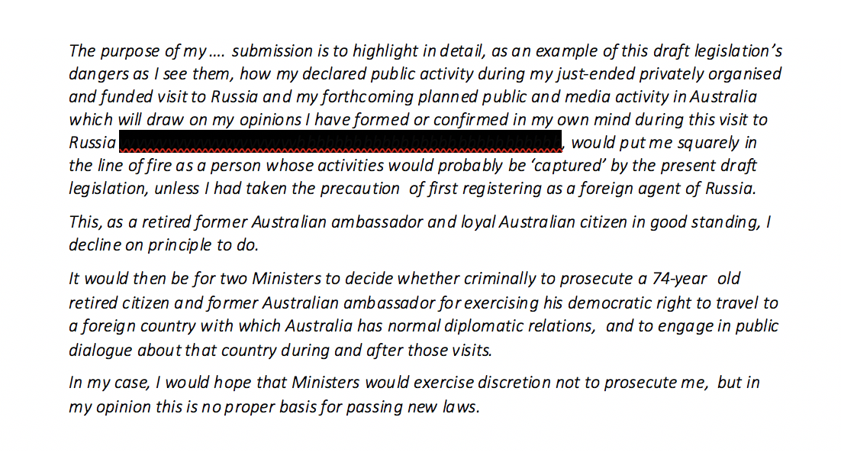
Note: these pages have been prepared for discussion purposes only and do not constitute legal advice. You should obtain your own legal advice based on your particular circumstances. © ALHR 2018
Notes:
Who will this legislation impact? All of us. As one retired diplomat wrote in his submission, some of which was redacted for publication….

Slide 19
How can we analyse whether legislation is good or bad?
Note: these pages have been prepared for discussion purposes only and do not constitute legal advice. You should obtain your own legal advice based on your particular circumstances. © ALHR 2018

Slide 20
How to analyse whether legislation is good or bad
Is it legal?
Does it impact on human rights?
Is it transparent and responsible?
Does it do what it is meant to do?
Is it fair?
Note: these pages have been prepared for discussion purposes only and do not constitute legal advice. You should obtain your own legal advice based on your particular circumstances. © ALHR 2018
Notes:
How can we analyse whether legislation is good or bad? we’re going to ask 5 questions:
Is it legal? To what extent does it impact on peoples’ human rights?
Is it transparent? Does it do what it is meant to do? Is it fair?

Slide 21
Is it Legal?
Note: these pages have been prepared for discussion purposes only and do not constitute legal advice. You should obtain your own legal advice based on your particular circumstances. © ALHR 2018
Notes:
What we mean by this is: is it consistent with superior laws including the Constitution?
This is where Australia’s lack of any Bill of Rights is clearly a problem.
There is no Commonwealth legislation that protects our rights of free speech, although the High Court has found in the Constitution an implied right of free political speech, the limits of which remain vague.
There is a strong argument that the foreign transparency scheme regime is in breach of that right.
But do you want to be the person running the high court case to avoid being jailed?
I should also mention here that to prove that legislation is valid under the Constitution - which only permits the Cwlth to legislate about limited topics - it is normal for the government to claim a connection to some topic on which the Cwlth clearly has legislative power - like national security. This is perhaps one of the reasons why national security is being redefined more and more broadly. The latest proposed definition now includes Australia’s economic interests. So if you damage those interests you have committed a major national security offence….

Slide 22
Does it impact on human rights?
Note: these pages have been prepared for discussion purposes only and do not constitute legal advice. You should obtain your own legal advice based on your particular circumstances. © ALHR 2018
Notes:
As mentioned, Australia has no Charter or Bill of Human Rights at a Federal level although there is some Commonwealth anti-discrimination legislation, and some State Bills of Rights.
However a human rights ‘balancing’ framework, as used in Europe and particularly by the German Constitutional Court, still provides a useful process for testing any policy or legislation. Let me tell you how the framework works.

Slide 23
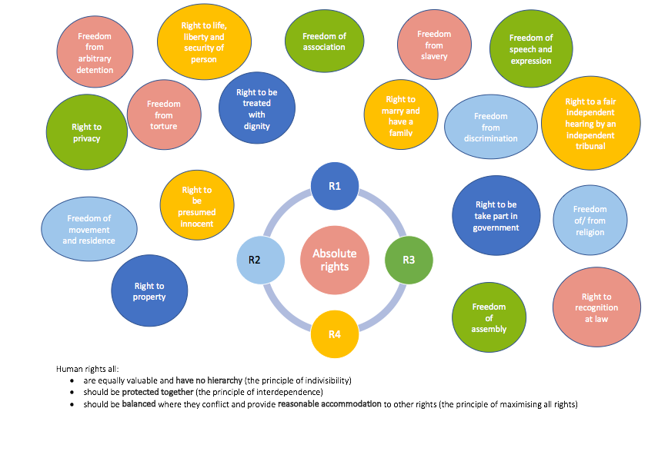
Note: these pages have been prepared for discussion purposes only and do not constitute legal advice. You should obtain your own legal advice based on your particular circumstances. © ALHR 2018
Notes:
In general terms, there is no hierarchy of human rights – all are equally valuable (the principle of indivisibility) and all should be protected together to the maximum possible (the principle of interdependence).
Some rights are expressed as absolutes, including: the right to be free from slavery, torture, cruel or inhuman or degrading punishment or treatment, or arbitrary deprivation of life, and the right to recognition as a person in law. The protection of one’s internal beliefs is also expressed to be an absolute right as an aspect of both freedom of speech and freedom of religion.
Absolute rights are also non-derogable in that they cannot be suspended even in a declared state of emergency. Other rights can be derogated or restricted for a limited period of time proportionate to the emergency and in a non-discriminatory way.
Subject to those absolutes, all rights must be balanced where they conflict and provide reasonable accommodation to other rights (the principle of maximising all rights). The balancing may also take into account other relevant factors other than human rights, for example property rights.
Rights that are not absolute may be subject to such legislative limitations or restrictions as are reasonable, necessary, proportionate and demonstrably justifiable. Good laws need to identify the harm to be addressed fairly narrowly, and respond directly, practically and proportionately to those harms. A ‘fishing net’ approach is ineffective, impractical and disproportionate.
Human rights entail both rights and obligations. In so far as we are ourselves entitled to the protection of human rights, we must also respect the human rights of others. Generally, where legislative protection is desired for particular behaviour it will be relevant to what extent that behaviour reflects good faith and respect for the rights of others. That is, there is no right to discriminate or attack the rights of others.
In addition, under the principle of legality, restrictions on rights must be clear, publicly accessible, non-retrospective, and people must be able to understand the circumstances in which restrictions might be imposed and foresee the consequences of their actions with a degree of certainty. This relates to the next questions.
Basically when laws, even those used to address a perceived harm or emergency, don’t support human rights but only infringe them, it’s a sure sign they are not good laws.

Slide 24
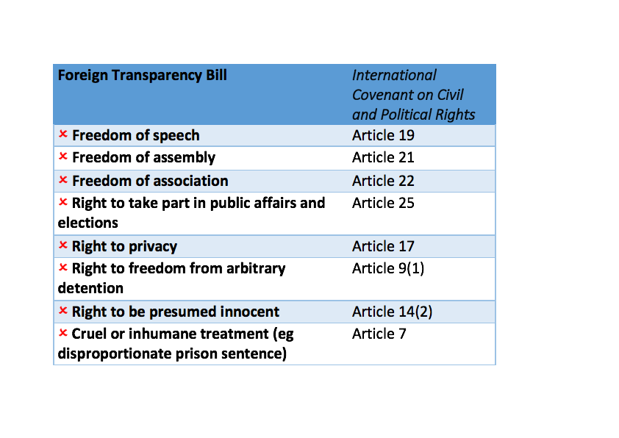
Note: these pages have been prepared for discussion purposes only and do not constitute legal advice. You should obtain your own legal advice based on your particular circumstances. © ALHR 2018
Notes:
So, what is the impact of this Bill on human rights?
There’s no doubt it shreds the right to privacy in relation to your political activity and your relationships with people who are not Australian citizens or permanent residents.
There’s no doubt it severely chills your rights around political participation, free speech, free assembly and free association….the legislation is Orwellian in its reach and its impact on ordinary citizens.
Why does this matter?
Because full political participation of individuals (and NGOs) is fundamental to free and open democracy.

Slide 25
Is it Transparent and Responsible?
Note: these pages have been prepared for discussion purposes only and do not constitute legal advice. You should obtain your own legal advice based on your particular circumstances. © ALHR 2018
Notes:
This question is also related to the next question - does the legislation do what it is meant to do? When we ask this question, we are wanting to know (see next slide)

Slide 26
Is it Transparent and Responsible?
Easy to understand
Uses terms with their normal meanings
No important provisions left to be determined through Regulations
No important decisions left to Ministerial discretion
Note: these pages have been prepared for discussion purposes only and do not constitute legal advice. You should obtain your own legal advice based on your particular circumstances. © ALHR 2018
Notes:
The law needs to be clearly expressed so that it is readily possible to understand who is affected and how. That means that terms should be used with their normal meanings.
It is bad legislative practice to leave essential terms or provisions to be provided in supplementary regulations – both because this renders the meaning of the principal legislation obscure, and because it allows the government to make major changes to the principal legislation by way of subordinate legislation which does not receive the same level of public scrutiny as the principal legislation, thus avoiding the government taking public responsibility for its actions.
It is also bad practice to leave prosecution under important legislation such as this to Ministerial discretion, for similar reasons.
This question is also related to the next question - does the legislation do what it is meant to do?

Slide 27
Is it Transparent and Responsible?
Easy to understand? | Complex
Uses terms with their normal meanings? | Normal terms redefined to mean something quite different
No important provisions left to be determined through Regulations? | Crucial provisions to be determined through Regulations
No important decisions left to Ministerial discretion? | Important decisions left to Ministerial discretion
Note: these pages have been prepared for discussion purposes only and do not constitute legal advice. You should obtain your own legal advice based on your particular circumstances. © ALHR 2018
Notes:
Unfortunately the legislation fails on all these grounds

Slide 28
Does it do what it is meant to do?
Identifies and responds to real harm - Practical and Proportionate
Works effectively in: carrying out its stated purpose being easy to comply with not being costly to comply with capable of being readily enforced
No overreach – proportionate response – minimises impact on freedoms and human rights. Restrictions on rights must be reasonable, necessary, proportionate and demonstrably justifiable.
Appropriate exemptions
Note: these pages have been prepared for discussion purposes only and do not constitute legal advice. You should obtain your own legal advice based on your particular circumstances. © ALHR 2018
Notes:
Identifying and responding to the real harm/ transparency
The harm the law is intended to address should be openly identified in good faith and the law should provide a direct and transparent response to that harm. There must be no pretending that the law is about one issue when it is really about another – and no disproportionate or unintended effects.
Proportionality
The law must be a proportionate and fair response to the identified harm. It should be tailored so as to minimise the legislative impact upon peoples’ freedoms and any unintended negative consequences. It should not be directly or indirectly discriminatory. Penalties should be proportionate to the harm caused and to the intent of the perpetrator. Penalties should not be excessive where there is no harm caused and/or no harm intended.
Practicality and Effectiveness
It needs to be likely that the law will be effective in carrying out its stated aims, capable of being reasonably complied with and capable of being readily enforced. Proportionality tests apply here too. The law needs to be framed in context and its potential impact needs to be examined closely. Exemptions and qualifications may need to be included.

Slide 29
Purpose of the Legislation
The scheme introduces registration obligations for persons or entities who have arrangements with, or undertake certain activities on behalf of, foreign principals. It is intended to provide transparency for the Australian Government and the Australian public about the forms and sources of foreign influence in Australia….
[because] Decision-makers in the Australian Government and the public should know what interests are being advanced in respect of a particular decision or process
Note: these pages have been prepared for discussion purposes only and do not constitute legal advice. You should obtain your own legal advice based on your particular circumstances. © ALHR 2018
Notes:
So, what is the intended purpose of the foreign interference transparency scheme?
It is (in the Explanatory Memorandum) said to be to ‘provide transparency’ about ‘forms and sources’ of foreign influence Australia.
But it goes far far beyond that. Input – or having information, which is really the only requirement under the legislation - is not influence. And not all influence is bad - as the Act assumes.
The legislation is effectively requiring ALL Australian – to- foreign communications about political matters - all INFORMATION, not all INFLUENCE - to be registered with the government, and this includes even totally private communications that don’t in any way amount to INFLUENCE, let alone harmful influence.

Slide 30
Does it do what it is meant to do?
Identifies and responds to real harm - Practical and Proportionate | Legislation is broader than it claims to be. Covers purely private activities with no real ‘foreign’ direction.
Works effectively in: carrying out its stated purpose being easy to comply with not being costly to comply with capable of being readily enforced | Goes much further than stated purpose Difficult to understand and to comply with. Expensive to comply with – greater impact on poorer compliers – especially if multiple registrations required for each ‘foreign’ person Hard to enforce
No overreach – proportionate response – minimises impact on freedoms and human rights. Restrictions on rights must be reasonable, necessary, proportionate and demonstrably justifiable. | Fishing net approach catches otherwise legal and non-harmful behaviour Restrictions on rights excessive and disproportionate
Appropriate exemptions | Exemptions insufficiently well drafted, too narrow
Note: these pages have been prepared for discussion purposes only and do not constitute legal advice. You should obtain your own legal advice based on your particular circumstances. © ALHR 2018
Notes:
So here again we suggest that the legislation fails on all fronts. It is not clear if multiple self-registrations (and multiple fees) would be required before one can speak to each ‘foreign’ friend or family member without being guilty of a crime. After all, if you tell your grandmother you are going on a demonstration tomorrow, she is likely to tell your grandfather…. Do you have to self-declare and self-register that they both ‘might’ know this?

Slide 31
Activity and other criteria
You are involved in specified activity or have entered into an arrangement to undertake the activity (whether or not you actually do these things)
Your purpose is ‘political or government influence’
You don’t fall within any of the exemptions
There is a foreign person (whether living in Australia or overseas) or entity who might know or expect that you would or might carry out the activity (whether or not you actually do)
Note: these pages have been prepared for discussion purposes only and do not constitute legal advice. You should obtain your own legal advice based on your particular circumstances. © ALHR 2018
Notes:
Let’s just examine again what is caught by the legislation and how extremely broad it is.

Slide 32
Activity covered: Communications activity (s 13)
defined in section 13(1) as
communicating, or
distributing
“information or material” including (as per section 13(2)) “information or materials in any form, including oral, visual, graphic, written, electronic, digital and pictorial forms.”
Exemption under section 13: publisher of a periodical, broadcaster of the relevant communication /carriage service provider
Note: no exemption for journalists who are not themselves publishers or broadcasters, no exemption for writers on social media (only ‘publishers’), no exemption for opinion pieces that are not editorials (see also s 28 exemption)
Note: these pages have been prepared for discussion purposes only and do not constitute legal advice. You should obtain your own legal advice based on your particular circumstances. © ALHR 2018
Notes:
Communications activity is defined very widely and the exemptions are couched in terms that are appropriate for ink and paper newspapers but completely inappropriate in terms of appropriate exemptions for the expression and sharing of political views in an electronically interconnected world. Most political journalism would not be exempt.

Slide 33
Activity covered: Lobbying
General political lobbying: lobbying any one or more of the following: (a) a Commonwealth public official; (b) a Department, agency or authority of the Commonwealth; (c) a registered political party; (d) a candidate in a federal election – [in each case] other than lobbying that is Parliamentary lobbying
Parliamentary lobbying: lobbying any one or more of the following persons: (a) a member of the Federal Parliament; (b) a person employed under section 13 or 20 of the Members of Parliament (Staff) Act 1984)
(lobbying is defined broadly)
Note: these pages have been prepared for discussion purposes only and do not constitute legal advice. You should obtain your own legal advice based on your particular circumstances. © ALHR 2018

Slide 34
Other Exemptions
Humanitarian aid or assistance (s 24):
A person is exempt in relation to an activity the person undertakes on behalf of a foreign principal if the activity is, or relates solely to, the provision of humanitarian aid or humanitarian assistance. [Given that any conduct can convey multiple messages to different audiences, it is likely to be virtually impossible for anyone to prove that their conduct had a sole purpose]
Legal advice or representation (s 25)
A person is exempt in relation to an activity the person undertakes on behalf of a foreign principal if the activity is solely, or solely for the purposes of, the provision of legal advice or legal representation in judicial, criminal or civil law enforcement inquiries, investigations or proceedings [same problem]
Diplomatic, consular etc activities (s 26)
Exempts such activities on behalf of foreign governments subject to certain conditions.
Religious lobbying for theocracies (s 27)
if: (a) the foreign ‘principal’ is a foreign government; and (b) the activity is solely, or solely for the purposes of, acting in good faith in accordance with the doctrines, tenets, beliefs or teachings of the particular religion of the foreign government. [It is not clear why this exemption should be granted as a matter of principle].
Note: these pages have been prepared for discussion purposes only and do not constitute legal advice. You should obtain your own legal advice based on your particular circumstances. © ALHR 2018
Notes:
The exemptions are generally too narrowly drafted. Strangely, there is an exemption for lobbying on behalf of theocracies.

Slide 35
Some news media (s 28) - and see s 13 as previously mentioned
for activities “solely, or solely for the purposes of, reporting news, presenting current affairs or expressing editorial content in news media. ” [No exemption for social media, no exemption for opinion pieces].
Commercial or business contractual negotiations (s 29(1))
If: the foreign ‘principal’ is a foreign business or individual and the activity is solely, or solely for the purposes of, the pursuit of bona fide business or commercial interests in relation to preparing to negotiate, negotiating, or concluding, a contract for the provision of goods or services, and “in no way” relates to national security, defence, or public infrastructure (within the meaning of the Criminal Code).
Commercial or business pursuit for disclosed employer (s 29(2))
If: the foreign ‘principal’ is a foreign public enterprise or business and the activity is a commercial or business pursuit (i) undertaken by an individual in his or her capacity as an employee of the foreign principal; or (ii) undertaken by the person under the name of the foreign principal.
Note: these pages have been prepared for discussion purposes only and do not constitute legal advice. You should obtain your own legal advice based on your particular circumstances. © ALHR 2018
Notes:
And the exemptions for business purposes are fairly wide. As mentioned, the exemptions for journalists/ opinion pieces /bloggers are far too narrow. Interestingly, there is no exemption for politicians – and parliamentary privilege will generally not be applicable in relation to the kind of communications to which the Bill will apply, and certainly will not apply to the individuals who will be primarily responsible for self-registering their communications with MPs.

Slide 36
Is it fair?
Note: these pages have been prepared for discussion purposes only and do not constitute legal advice. You should obtain your own legal advice based on your particular circumstances. © ALHR 2018

Slide 37
Is it fair?
Proportionate penalties to offence | Penalties not proportionate
No strict liability | Strict liability
No presumption of guilt / deemed offence where defendant must prove innocence | Inversion of presumption of innocence/ deemed offences
Penalties only apply where harm caused | Penalties apply irrespective of harm caused
Penalties only apply where harm intended | Penalties also apply for reckless behaviour where no harm intended
Note: these pages have been prepared for discussion purposes only and do not constitute legal advice. You should obtain your own legal advice based on your particular circumstances. © ALHR 2018

Slide 38
Any comparable overseas legislation? What has been the practical impact?
Note: these pages have been prepared for discussion purposes only and do not constitute legal advice. You should obtain your own legal advice based on your particular circumstances. © ALHR 2018
Notes:
And the last question that we need to ask is: has there been any comparable overseas legislation? And what has been its impact?

Slide 39
Other Countries with similar legislation
Electoral Legislation Amendment (Electoral Funding and Disclosure Reform) Bill 2017 – much similar legislation, including in South Africa under the apartheid regime, and more recently worldwide over the last 10 years
Foreign Influence Transparency Scheme Bill 2017 – no similar legislation that we can find to date – nothing so overbroad in its reach, repressive in its effect and excessive in its punishments
Note: these pages have been prepared for discussion purposes only and do not constitute legal advice. You should obtain your own legal advice based on your particular circumstances. © ALHR 2018
Notes:
There are quite a few countries with legislation which is similarly repressive of civil society organisations, but we could find none which has legislation comparable in reach and in negative impact to the so-called ‘Foreign Influence Transparency Scheme Bill’.

Slide 40
Non-exhaustive list of countries which have imposed legal constraints on the foreign funding of civil society organisations /political activities of civil society organisations
[Source: International Centre for Not-for-Profit Law]
Note: these pages have been prepared for discussion purposes only and do not constitute legal advice. You should obtain your own legal advice based on your particular circumstances. © ALHR 2018
Notes:
Here are some of the countries which have imposed varying degrees of legal constraints on the foreign funding of civil society organisations or the political activities of civil society organisations, and which continue to impose such constraints.

Slide 41
According to the International Centre for Not-for-Profit Law:
Costa Rica
Civil society is vibrant and active. Human rights defenders, international NGOs and others operate without undue government interference. CSOs are free to participate in policy making.
the Kyrgyz Republic and Kazakhstan
Restrictive legislation proposed in 2014 following the Russian model was strongly resisted and ultimately rejected in the Kyrgyz Republic and although Kazakhstan introduced repressive legislation, more recently some has been revised following CSO advocacy.
Lebanon and Morocco
These have some of “the most enabling legal and regulatory environments for civil society in the entire Arab world.”
Note: these pages have been prepared for discussion purposes only and do not constitute legal advice. You should obtain your own legal advice based on your particular circumstances. © ALHR 2018
Notes:
And here are some countries that we should look to as bastions of human rights in comparison to Australia on this question.

Slide 42
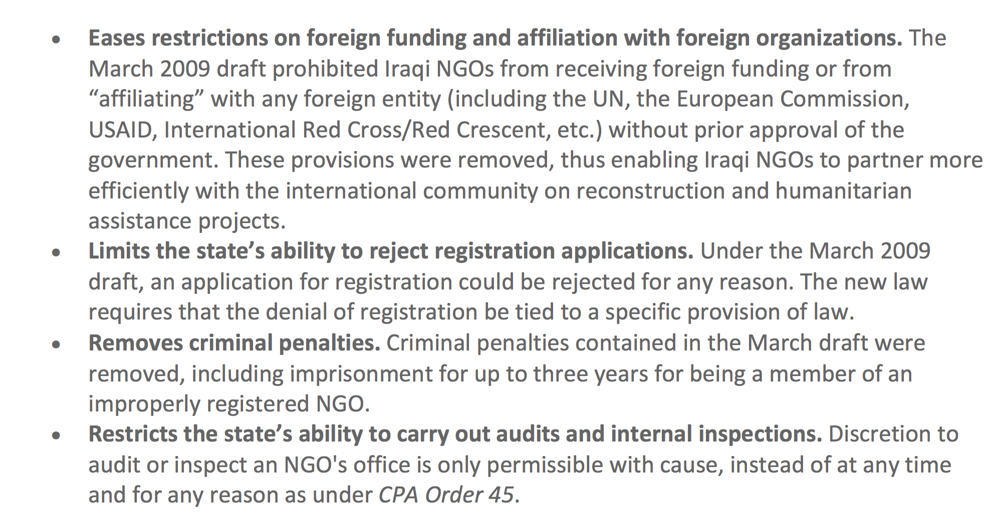
… and Iraq, whose 2010 law:
xx
Source: International Centre for Not-for-Profit Law
Note: these pages have been prepared for discussion purposes only and do not constitute legal advice. You should obtain your own legal advice based on your particular circumstances. © ALHR 2018
Notes:
Not to mention Iraq …. the Iraqi law No 12 of 2010 appears to be going in the opposite direction to Australia: It….(see slide)

Slide 43
What has been the practical impact?
Note: these pages have been prepared for discussion purposes only and do not constitute legal advice. You should obtain your own legal advice based on your particular circumstances. © ALHR 2018
Notes:
So to return to our question: what has been the impact of these similar laws overseas?

Slide 44
Russia’s “foreign agents” law is bankrupting campaigners and activists - Alexei Kozlov, 10 November 2017, opendemocracy.net
Many NGOs have been forced to shut down.
India's Government barred in excess of 10,000 NGOs from receiving foreign funds in 2015, in what advocates say is a misuse of laws designed to restrict foreign influence of Indian politics
Note: these pages have been prepared for discussion purposes only and do not constitute legal advice. You should obtain your own legal advice based on your particular circumstances. © ALHR 2018
Notes:
So to return to our question: what has been the impact of these similar laws overseas? The news isn’t good.

Slide 45
Problems with the Foreign Influence Transparency Scheme Bill 2017
Far too broad - minimum foreign connections extremely tenuous, “purpose” of “political or governmental influence” very broad
Appears to capture both private and public communications
No exemptions for public protest
No exemptions for contacting your federal MP
No exemptions for writing a public letter or making a public comment
Allows foreign donor activity not caught by Cwlth Electoral Act
Exemptions for journalists and humanitarian aid too narrow
Note: these pages have been prepared for discussion purposes only and do not constitute legal advice. You should obtain your own legal advice based on your particular circumstances. © ALHR 2018
Notes:
To summarise, these are some of the problems with the Bill, being a Bill which goes far beyond the legislation of any of the countries we have just been considering.

Slide 46
The National Security Legislation Amendment (Espionage and Foreign Interference) Bill 2017 is said to amend the Criminal Code Act 1995 to:
amend and introduce espionage offences relating to dealings with information, including solicitation and preparation and planning offences;
replace the existing sabotage offence with new sabotage offences relating to conduct causing damage to a broad range of critical infrastructure that could prejudice Australia’s national security;
introduce a new offence relating to theft of trade secrets on behalf of a foreign government;
introduce new offences relating to foreign interference with Australia’s political, governmental or democratic processes;
amend existing, and introduce new, offences relating to treason and other threats to national security, such as interference with Australian democratic or political rights by conduct involving the use of force, violence or intimidation;
Note: these pages have been prepared for discussion purposes only and do not constitute legal advice. You should obtain your own legal advice based on your particular circumstances. © ALHR 2018
Notes:
Another ‘foreign interference’ provision which is being introduced under different legislation is also worth noting.

Slide 47
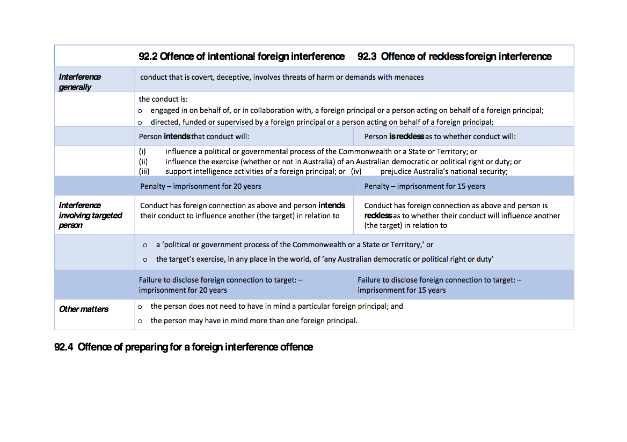
Note: these pages have been prepared for discussion purposes only and do not constitute legal advice. You should obtain your own legal advice based on your particular circumstances. © ALHR 2018
Notes:
Subsection (1) of the offences of intentional foreign interference and reckless foreign interference relate to covert or deceptive conduct which is understandable. But subsection (2) of each of those provisions relates to conduct which has some foreign connection (as per subsection (1)) but is only about influencing another person in relation to political or government processes, or the exercise of ‘any Australian democratic or political right or duty’ (which is not defined). The penalty for the ‘influencer’ for not contacting the target to notify them of the proposed influence is imprisonment for 20 years (if intentional) or 15 years (if reckless) – even if the proposed influence was completely benign. And it is provided that the influencer ‘does not need to have in mind a particular foreign principal’ or ‘may have in mind more than one foreign principal’. It is not at all clear how something so nebulous can be disclosed to a ‘target’.

Slide 48
Summary
The Foreign Influence Transparency Scheme provides for an extensive system of self-regulation and self-notification to Government including of harmless private conversations with persons who are not Australian citizens or permanent residents if the conversations are related to any issue on which the Australian person has an intention of being politically active, whether in public or in private
Failing to self report even when there was no political activity at all - but only the discussion with a foreign person of the possibility of political activity - can be penalised with imprisonment of up to 5 years and, if there was political activity, by imprisonment of up to 7 years. This includes absolutely normal day to day expression of political views where no harm is caused or where the outcome may be beneficial.
Clearly a scheme like this which could require multiple registrations by approximately half of Australia so we can have ‘free’ discussions with our non-citizen relatives without being sent to jail is entirely unworkable. One fears that it is legislation intended to enable a government to retrospectively cherrypick and imprison its detractors for so-called past ‘crimes.’
some provisions in the National Security Legislation Amendment (Espionage and Foreign Interference) Bill 2017 also provide for criminal penalties for ‘foreign influence’ activities which are very unclear in scope and apply even if no harm is caused. Similar concerns apply there.
the impact of similar but much less wide-reaching laws in other countries has been severe. The Australian legislation is even more repressive and if enacted, will amount to the most severe legislative repression of political activity in the world
Note: these pages have been prepared for discussion purposes only and do not constitute legal advice. You should obtain your own legal advice based on your particular circumstances. © ALHR 2018

Slide 49
Resources
International Centre for Not-for-Profit Law: http://www.icnl.org
Text of Foreign Influence Transparency Scheme Bill 2017 – https://www.aph.gov.au/Parliamentary_Business/Committees/Joint/Intelligence_and_Security/TransparencySchemeBill
Text of National Security Legislation Amendment (Espionage and Foreign Interference) Bill 2017 - https://www.aph.gov.au/Parliamentary_Business/Committees/Joint/Intelligence_and_Security/EspionageFInterference
Text of Electoral Legislation Amendment (Electoral Funding and Disclosure Reform) Bill 2017 https://www.aph.gov.au/Parliamentary_Business/Committees/Joint/Electoral_Matters/ELAEFDRBill2017
Note: these pages have been prepared for discussion purposes only and do not constitute legal advice. You should obtain your own legal advice based on your particular circumstances. © ALHR 2018

